Slide 1
Protection of personal information in Victorian universities
Report of examination under s 8C(2)(b) Privacy and Data Protection Act 2014

Slide 2
Why universities?
Hold high volumes of personal information and other sensitive information
Significant security breaches have affected Australian universities in recent years
Unlike other Victorian public organisations, universities are primarily subject to principles-based regulation of their personal information security practices (‘reasonable steps to secure personal information’).
Notes:
Please feel free to contact us

Slide 3
Responsibility to protect personal information
Eight Victorian universities are bound by Information Privacy Principle (IPP) 4 in Schedule 1 of the Privacy and Data Protection Act 2014 (Vic), which states:
IPP 4.1: An organisation must take reasonable steps to protect the personal information it holds from misuse and loss and from unauthorised access, modification or disclosure.
IPP 4.2: An organisation must take reasonable steps to destroy or permanently de-identify personal information if it is no longer needed for any purpose.
IPP 4.1 implies a risk-based approach to protecting personal information security.
Notes:
Please feel free to contact us

Slide 4
Risk-based approach to personal information security
To take a risk-based approach to personal information security universities should:
Identify the personal information they hold
Identify the security value and sensitivity of that information
Identify and manage security risks to the information
Apply protections proportionate to the value and risks to the information
Our examination was framed around these activities.
Notes:
Please feel free to contact us

Slide 5
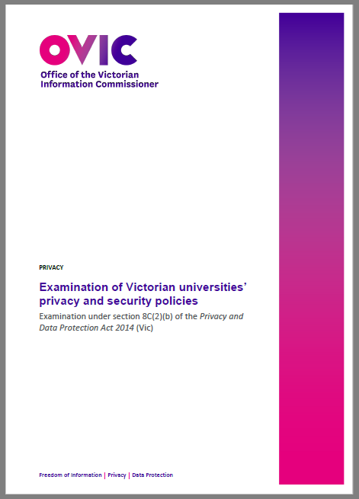
OVIC examination report
Available online at:
https://ovic.vic.gov.au/regulatory-approach/investigations-audits-examinations/examination-of-victorian-universities-privacy-and-security-policies/

Slide 6
What we examined
OVIC examined Victorian universities’:
privacy and information security policies and procedures
methods of identifying and recording holdings of personal information
approaches to assessing the security value or nature of personal information
approaches to risk management with respect to personal information security risks.
Reviewed documented policies and procedures; did not examine application in practice.
Notes:
Please feel free to contact us

Slide 7
What we found – overview
All universities had privacy and security policies in place, and there were areas of consistent performance.
Some universities did not have procedures to methodically identify personal information holdings.
Strong focus on cybersecurity – less focus on other security areas.
Absence of procedures to destroy or deidentify personal information.
Varied approaches to with sharing personal information with third parties.
Notes:
Please feel free to contact us

Slide 8
What we found - areas of strong performance
We found that all Victorian universities:
have a data breach response plan that includes the steps contain, assess, notify and review
conduct Privacy Impact Assessments (PIAs) for significant new projects involving personal information
conduct privacy and data security online training for staff
have prioritised ICT and cyber security risks.
Notes:
Please feel free to contact us

Slide 9
What we found – identifying and assessing value of PI
Universities need to take ‘reasonable steps’ to protect personal information.
Identifying what is ‘reasonable’ requires an understanding of what information is held and its sensitivity.
Not all universities had a procedure for cataloguing the personal information they held or assessing its value – e.g., an Information Asset Register (IAR).
Notes:
Please feel free to contact us

Slide 10
What we found – identifying and assessing value of PI
Notes:
Please feel free to contact us

Slide 11
What we found – focus on cybersecurity and ICT risk
Notes:
Please feel free to contact us

Slide 12
What we found – destroying personal information
While all universities had records management policies, not all of them dealt with the destruction of personal information:
Three universities’ policies provided for disposal of information when permitted by the university’s Retention and Disposal Authority
Only one university’s policy referred specifically to the obligation to destroy personal information when no longer required.
No policies or procedures we reviewed contained instructions for staff about how records should be destroyed or deidentified where it is no longer needed.
Notes:
Please feel free to contact us

Slide 13
What we found – sharing personal information
Universities may share personal information with third parties. Sharing personal information with third parties creates significant privacy risks.
However, OVIC found that of eight universities:
Four said that staff need to obtain their legal teams’ approval for sharing personal information.
Two said they used PIAs to determine if sharing of personal information is appropriate.
Only one university had a documented procedure for deciding when it was appropriate to share personal information with third parties.
Notes:
Please feel free to contact us

Slide 14
Recommendations to Victorian universities
OVIC recommended Victorian universities consider, where they have not already done so:
implement policies that clearly set out expectations on staff regarding destruction of personal information.
include in data breach response plans a step that requires staff to consider whether notification to OVIC is appropriate.
document their approach and requirements when sharing personal information with third parties.
make privacy and information security training available to all personnel that have access to personal information held by the university, including contractors.
Notes:
Please feel free to contact us

Slide 15
Considerations for other universities
Consider whether your university has:
procedures to identify the personal information it holds, determine its security value, and apply proportionate security controls?
procedures to manage third party risk when sharing personal information?
established the categories of policies, procedures, and mechanisms listed at pages 10 and 21-23 of OVIC’s examination report?
See: OVIC (2021) Examination of Victorian universities’ privacy and security policies. Available at www.ovic.vic.gov.au.
Notes:
Please feel free to contact us

