Slide 1
Data use and protection: Key issues and future direction
Sven Bluemmel
Victorian Information Commissioner

Slide 2
Outline
University of Melbourne: August 2022
Information rights and oversight mechanisms in Victoria
The power and value of data
Data sharing: Risks and benefits
Guidance for undertaking surveillance
What have we learned from the pandemic?
Regulatory priorities: Where OVIC is focussing its efforts
What does the future hold?

Slide 3
Information Rights and Oversight Mechanisms in Victoria
University of Melbourne: August 2022
Privacy and Date Protection Act 2014
Freedom of Information Act 1982
Office of the Victorian Information Commissioner
Freedom of Information
Privacy
Information Security (“data protection”)
A combination of proactive and reactive regulatory action

Slide 4
The power and value of data
University of Melbourne: August 2022

Slide 5
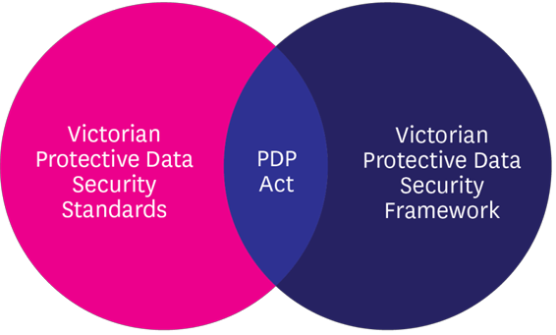
The Victorian Protective Data Security Framework
The Framework has been developed to monitor and assure the security of Victorian public sector information.
To do this, OVIC monitors and measures VPS organisations’:
implementation of the Standards; and
compliance with the PDP Act.
(Part 4)

Slide 6
The VPDSS: A holistic approach to information safety
The Victorian Protective Data Security Standards (VPDSS) cover all aspects of the business
INFORMATION SECURITY
PERSONNEL SECURITY
Information
PHYSICAL SECURITY
ICT SECURITY
GOVERNANCE

Slide 7
Data sharing
University of Melbourne: August 2022
Data sharing examples
Child Information Sharing Scheme
Family Violence Information Sharing Scheme
The risk of re-identification
Kevin Rudd was re-identified from a de-identified Medical Benefits Scheme and Pharmaceutical Benefits Scheme dataset
University of Melbourne academics re-identified themselves and several other individuals from a de-identified set of Myki ‘touch on’ / ’touch off’ data

Slide 8
Surveillance and facial recognition
University of Melbourne: August 2022

Slide 9
OVIC Guiding Principles for Surveillance
University of Melbourne: August 2022
Principle 1: Legality
Principle 2: Legitimate aim
Principle 3: Necessity
Principle 4: Proportionality
Principle 5: Safeguards
Principle 6: Non-discrimination
Principle 7: Complaints and remedy

Slide 10
What have we learned from the pandemic?
University of Melbourne: August 2022
Crisis response works better when people trust in their institutions
Government can earn trust by being open, transparent and respectful of privacy – it can erode trust by being the opposite
People want to be kept informed – the hunger for information did not decrease during the pandemic
National Cabinet is not “the Cabinet”

Slide 11
Regulatory priorities: Where OVIC is focussing its efforts
University of Melbourne: August 2022
Compliance with the FOI Professional Standards
Privacy and security when outsourcing
Information governance during crises
Privacy, security and transparency in emerging technologies

Slide 12
Some questions for the future
University of Melbourne: August 2022
Are we reaching the limits of principles-based privacy protection?
Do we need special rules for certain technologies like facial recognition or for vulnerable individuals like children?
Should we consider a so-called “right to be forgotten”?
Should we stop pretending that information security can ever be guaranteed?
Can government’s information handling earn the people’s trust before the next crisis?

Slide 13
Contact
www.ovic.vic.gov.au
1300 006 842
Twitter: @OVIC_AU

