Slide 1
ISACA Annual General Meeting
Sven Bluemmel, Victorian Information Commissioner
26 May 2022

Slide 2
What will we cover?
ISACA AGM 26 May 2022
Victorian Protective Data Security Framework and Standards
Outsourcing and information security: lessons from an OVIC investigation
Artificial intelligence and facial recognition: OVIC’s view
Lessons from the pandemic

Slide 3
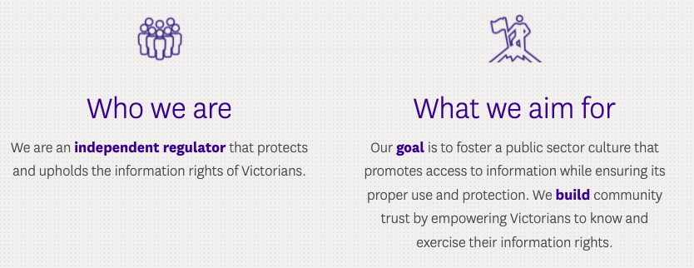
Office of the Victorian Information Commissioner
ISACA AGM 26 May 2022

Slide 4
Privacy Awareness Week 2022
ISACA AGM 26 May 2022

Slide 5
Victorian Protective Data Security Framework and Standards

Slide 6
Victorian Protective Data Security Framework and Standards
ISACA AGM 26 May 2022
PDP Act
2014
Assurance
Principles
Assurance
Policy
Standards
Security guides
Agency specific policies and procedures
Assurance

Slide 7
Outsourcing and the Privacy and Data Protection Act 2014 (Vic): lessons from an OVIC investigation

Slide 8
ISACA AGM 26 May 2022
“Government can outsource the delivery of services, but not its responsibility to protect the information it holds.”
Media release: Information Commissioner publishes report on investigation into a data breach involving Department of Health and Human Services (11 March 2021)

Slide 9
OVIC’s CRISSP investigation
ISACA AGM 26 May 2022
A serious breach of the Information Privacy Principles
Compliance notice and report issued
Incident caused by:
human error in failing to deprovision systems access
inadequate protections to address the risk of human error

Slide 10
Themes from the investigation’s recommendations
ISACA AGM 26 May 2022
Regularly check user access lists for systems and implement a procedure to periodically check the currency of user lists for a system.
Regularly provide both general and specific privacy and security training to staff according to their role and the types of information and systems they can access.
Use a risk-tiering framework for managing CSPs.
Simplify contractual frameworks and guidance materials for systems.

Slide 11
Artificial intelligence and facial recognition

Slide 12
Just because you can, does not mean you should.
ISACA AGM 26 May 2022

Slide 13
Lessons learned from the pandemic

Slide 14
Lessons learned from the pandemic
ISACA AGM 26 May 2022
Trust
Respect
Privacy
Transparency
Security

Slide 15
Resources
ISACA AGM 26 May 2022
OVIC, Engaging contracted service providers (Guidelines for outsourcing in the Victorian public sector, checklist, case studies)
OVIC, Unauthorised access to client information held in the CRISSP database: Investigation under section 8C(2)(e) of the Privacy and Data Protection Act 2014 (Vic)
OVIC, Artificial intelligence – Understanding Privacy Obligations
OVIC, Artificial intelligence and privacy – Issues and challenges
OVIC, Biometrics and privacy – Issues and challenges
Global Privacy Assembly, 42nd closed session of the Global Privacy Assembly (October 2020), Adopted Resolution on facial recognition technology

Slide 16
Contact us
ISACA AGM 26 May 2022
enquiries@ovic.vic.gov.au
@OVIC_AU
1300 006 842
au.linkedin.com/company/ovicgov
www.ovic.vic.gov.au

