Slide 1
Rights, privacy, access and governance: a new approach for modern government
Sven Bluemmel
Victorian Information Commissioner
Monash University
1 May 2018

Slide 2
Today
The Office of the Victorian Information Commissioner
Who are we
What we do
FOI - processes, legal rights
Privacy - PDP Act Framework, IPPs
Data Protection - framework and oversight
The fundamental importance of Information rights in the digital age

Slide 3
Who are we?

Slide 4
The Establishment of the Office of the Victorian Information Commissioner
“The creation of this new office will provide more proactive and integrated FOI, privacy and data protection leadership in Victoria, particularly by driving the cultural shifts necessary to improve the way government manages and provides access to information.”
Second reading speech of the Freedom of Information Amendment (Office of the Victorian Information Commissioner) Act 2017

Slide 5
Why is this work important?
Information rights are fundamental to individuals participating in society and government
Our roles -
Oversight over FOI, Data Protection and Privacy in Victoria
Independent voice
Educate and promote better decision making
Monitor compliance
Conduct reviews of FOI decisions
Investigate FOI and privacy complaints and breaches
Report to Parliament on operation of FOI Act

Slide 6
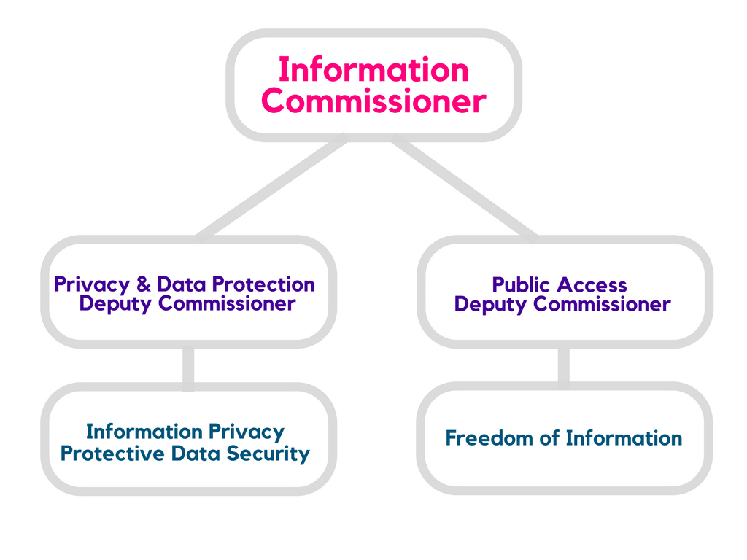
OVIC
A single, independent regulator now responsible for the oversite of freedom of information, privacy and data protection in Victoria
Notes:
OVIC’s establishment signals a new direction for engagement with public sector agencies and entities to assist them in information management and access issues and to drive positive systemic and cultural change.
It also means we can build a consistent regulatory approach across all three areas of FOI, privacy and data protection. This will not always be straightforward, as there can be a degree of tension between these areas.
However, I see the establishment of OVIC as an opportunity to acknowledge and deal with those tensions, allowing us to provide clear and consistent guidance to the Victorian State and local public sector. Having those elements administered by a single regulator also reflects the reality that all aspects of information management can have very real impacts on the lives of individual citizens.
Key changes to the Freedom of Information Act 1982 (Vic) and limited changes to the Privacy and Data Projection Act 2014 (Vic) commenced 1 September 2017
Broader external review and complaints jurisdiction in FOI
Coercive powers and own-motion investigations
Increased educative role

Slide 7
The origins of Freedom of Information
What is FOI?
Freedom of Information – a mechanism by which anyone can access documents held by a government agency or Minister
A fundamental change to the relationship between citizens and their government
Why is the concept of FOI important?
Cornerstone of democracy
Promotes good government
Allows citizens to be participants, not just spectators
Notes:
Firstly, what exactly is FOI? The concept originated with the abolition of censorship of the press, but today it is more focused on providing access to information held by governments.
It actually came about during the Age of Enlightenment in Sweden – First ever FOI Act was from 1766 called “His Majesty’s Gracious Ordinance Relating to Freedom of Writing and of the Press”, More commonly now it is referred to as ‘Freedom of the Press’. It abolished political censorship & allowed public access to government documents. The proclamation even made reference to “abuses and illegalities” being “revealed to the public through the press”, and that knowledge of these abuses would provide “unrestricted mutual enlightenment” and “improve morality and obedience to the laws” and allow citizens “to gain improved knowledge and appreciation of a wisely ordered system of government”.
So, you can already get a sense from that about why FOI is important. FOI legislation forms an essential part of the democratic framework, which is vital in countries such as ours where voting is compulsory. Specifically, FOI allows for more informed voting to occur by allowing citizens access to information regarding government’s activities, which is only limited in certain, narrow circumstances. Giving citizens this information helps them to exercise their rights & responsibilities and make a more informed decision regarding who they want to elect into government. In addition, FOI promotes good government by discouraging inefficient or inappropriate practices and also gives individuals control over their personal information, including the right to amend information about them that is incorrect in some way.
When the Victorian FOI Act was introduced, The Age quoted John Cain Sr (who was then Premier) who said “The Act was aimed at saying the public has an entitlement to know. The public service has custody and access to documents, and they have an obligation to serve the public by releasing them.” The Herald Sun reported that “FOI laws were driven by the public’s demand to be kept informed. They are the extension of basic democratic rights.”
FOI laws form a vital part of a broader network of laws & mechanisms that affect the overall transparency of government – these include information privacy laws (that are sometimes entwined with FOI), public records laws, whistleblower protections and laws requiring proactive disclosure.

Slide 8
Freedom of Information today
Australia
Freedom of Information Act 1982 (Cth)
Victoria followed six months later
All states and territories now have FOI laws in operation
Rest of the world
Over 100 countries in the world now have FOI legislation
Known by a variety of names (e.g. Right to Know, Sunshine Laws)
All have common thread of promoting access to government-held information at minimal cost
Notes:
Today, FOI looks very different from the Freedom of the Press legislation that was passed in Sweden all those years ago.
The first FOI legislation in Australia was passed in 1982 and it was the first national legislation of its kind in a country with a Westminster style of government. Victoria was the first Australian state to pass FOI legislation – 6 months after the Commonwealth Act. Today, there are FOI laws in every other Australian state and territory, as well as in over 100 countries worldwide. These are known by a variety of names including Open Records laws, Right to Know, Access to Information or Sunshine Laws – named for the concept of “letting the sun shine in” on government practices.
Generally what do all of these FOI laws across the world have in common? – Essentially, the laws allow for requests to be made for government-held information, and for documents to be received at no or minimal cost, barring some narrow exceptions. Some laws include other key elements to promote and facilitate access to information held by government, such as:
the duty of government to publish certain types of current information,
the automatic expiry of the ability to claim an exemption or automatic publication of documents after a certain time (e.g. historical cabinet/secret documents)
conducting decision-making (such as meetings) openly or in accordance with set procedures,
a general obligation on government to promote openness and transparency.
Most Acts across the world also provide a mechanism for people to alter or amend incorrect personal records.

Slide 9
Who is covered
government departments and statutory agencies
government schools, universities and TAFEs
public hospitals
local councils
Ministerial offices
Notes:
First of all, we need to consider to whom the FOI Act applies. Essentially, the answer to this is all government bodies, including departments, statutory agencies (such as Family Safety Victoria), government schools, universities, TAFEs, public hospitals, local councils and Ministerial offices.
Private organisations are not subject to the Act. This has interesting implications in situations where governments are more and more frequently contracting out elements of their work to private organisations. We will be looking at further challenges to the FOI Act later in the session.

Slide 10
Video – FOI and popular culture
ABC: Utopia, Series 2, Rhonda and Nat handle a freedom of information request
Notes:
References to FOI frequently feature in popular culture, such as in the ABC program ‘Utopia’. Let’s have a quick look at how Rhonda and Nat handle an FOI request.
This clip humorously depicts some of the misconceptions about FOI requests and how they are handled by government agencies. Today, we hope to dispel some of those misconceptions.

Slide 11
Applying for access
A request is only valid if:
It is in writing; and
It is accompanied by the application fee; and
It is clear, so that a reasonable officer of the Agency can identify what is being sought
Agencies have an obligation to assist applicants make valid requests
Notes:
Has anyone here ever made an FOI request? e.g. Applied to hospital for a copy of your health record? Applied to your local council for documents relating to a council project or parking tickets? If no, perhaps our presentation will inspire you to make a request.
How does the FOI process start? It begins when an agency receives a request from a member of the public. It could be an individual, someone from the media, an MP or an organisation.
The request must be valid – section 17 of the FOI Act provides the minimum requirements for making a request it must be in writing and it must be accompanied by the application fee equal to 2 fee units. Currently, the fee is $28.40 (it increases each financial year). The application fee may be waived or reduced if it would cause hardship to the applicant. In practice, most agencies will accept proof of pension or concession entitlements in order to waive the application fee. It also must be clear as to what the FOI request is seeking, meaning it must contain sufficient information to enable the agency to identify the documents.
So what happens if a request doesn’t meet these requirements? The Act says that an agency has a duty to assist an applicant with making a valid and clear request, and must give the applicant a reasonable opportunity to consult with the Agency. In practice, this means writing or speaking to the applicant to find out what they’re looking for and helping them re-word their request in a way that will enable the Agency to process it.
Lastly, it’s important to note that all of these requirements apply to requests made within the provisions of the FOI Act, but there are many opportunities for agencies to engage in the proactive release of documents or information outside of FOI, in order to assist applicants. Where the documents being sought are already publicly available, then applicants should be directed to that information. When an agency receives a request where it is apparent that no exemptions would apply, it could release that information outside the FOI Act. Our office encourages agencies to proactively release information where possible.

Slide 12
What is a document
A document can be:
Paper documents
Screen dumps
Audio and video
Post-it notes
Emails
Photos
And more. Much, much more….
Notes:
despite the name of the Act, it only applies to ‘documents’ and not necessarily information. The answer to this question might seem obvious, but what is a document? A document can be:
Case notes
Screen dumps
Audio and video
Post-it notes
Emails
Photos
And more!
In addition to a document in writing, s5 of the Act defines document as including
Any book, map, plan, graph or drawing
Photographs, films, labels, discs, soundtracks
Electronic material including databases and emails
Local computer drives ( e.g. “G” and “H” drives)
Official files, staff diaries, post-it notes etc.
“(f) anything whatsoever on which is marked any words figures letters or symbols which are capable of carrying a definite meaning to persons conversant with them;”
And any copy, reproduction or duplicate of any of the above.
A further two important points about documents – they need to be:
Relevant to the terms of the FOI request, and be in existence at the time of the request;
In the possession of the agency. This includes documents that the agency may not physically have, but has the right to call for (e.g. held by a sub-branch of the agency or other entity related to the agency, or is held at the Public Records Office). Just FYI, we call this “constructive possession”.

Slide 13
Exemptions in the FOI Act
28 – Cabinet documents
29 – Matter communicated by a foreign country, the Commonwealth, any other State or a Territory
29A – Documents affecting national security, defence or international relations
29B – Documents of Court Services Victoria
30 – Internal working documents
31 – Law enforcement documents
31A – Documents relating to IBAC
32 – Documents affecting legal proceedings
33 – Document affecting personal privacy
34 – Documents relating to trade secrets etc.
35 – Documents containing material obtained in confidence
36 – Disclosure contrary to public interest, economy etc.
37 – Certain documents arising out of companies and securities legislation
38 – Documents to which secrecy provisions of enactments apply
38A – Council documents

Slide 14
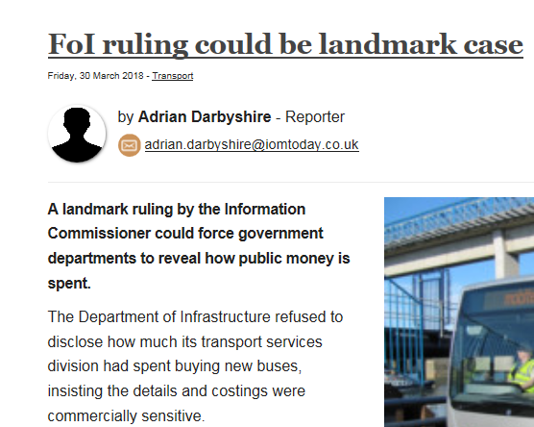
FOI in the media
Notes:
Many of you may have seen references to FOI in the media recently. 2018 is an election year in Victoria, which means now more than ever, there is a focus on FOI. The above are all recent headlines involving FOI.
Every year, there are hundreds of newspaper articles and TV and radio spots in Victorian media that specifically mention freedom of information. And that doesn’t include blogs, social media or non-mainstream news and comment sources. FOI officers have even been named in parliament. All of these articles cover a vast array of issues from a whole host of agencies – from small public authorities to local councils to the large departments. The kinds of issues raised in the articles relate to everything from specific incidents involving one individual to large multi-billion dollar projects.
There is a good reason for all the headlines. Victorians are seeking and receiving access to government information in increasing numbers.
Some statistics from our Annual Report: In 2016-2017 financial year, 36,219 FOI applications were lodged across the state.
In 65.6% of those requests, the agency granted full access. In 30.5%, partial access was given. And only 3.9% were refused in full.
The number of FOI requests has been growing year by year.
The majority of requests are personal – i.e. people asking for documents about themselves

Slide 15
Is it working?
Victoria was one of the first Australian jurisdictions to introduce FOI laws.
Other Australian jurisdictions have undertaken fundamental reviews of their FOI laws and processes, moving from a “pull” model to a “push” model.
Victoria’s FOI Act is still a first generation push model and the model and its application have been criticised, including by the Auditor General in 2012
1984-85: 4,702 FOI requests in Victoria
2016-17: 36,219 FOI requests in Victoria
Notes:
Justifications for FOI laws are in essence:
that transparency is essential to political accountability, and to discouraging corruption and other forms of wrongdoing;
that the publication or release of information about the structure, organisation and workings of public sector bodies promotes increased participation in decision making; and
that individuals should be able to access their personal records to assure themselves that they are accurate and complete, and to seek their amendment if they are not.
Today — more than ever — those justifications resonate, in our digitised, commercialised, democratic society. The volume and value of information collected and its use by government agencies continues to dramatically expand. The potential for the abuse of power, and the need to hold governments to account for their decision making are still very real.
Journalist Kerry O’Brien presented the annual Solomon Lecture on International Right to Know Day in Brisbane on 28 September last year. He had some fascinating first hand insights into the media’s role in exposing corruption and keeping the community informed on government decisions in the decades pre and post-dating FOI legislation. He also discussed the current state of local and world politics, and argued that it is now just as critical as ever that the media have access to public sector information.
The context / challenges
Unlike elsewhere in Australia, Victoria’s FOI Act has not undergone a radical overhaul since its enactment. In the last 10 years we have seen, in a number of Australian jurisdictions, the introduction of ‘second generation’ FOI laws. These pieces of legislation enshrine in law a commitment to proactive release and provide that formal FOI requests are to be used as a last resort. And there has been discussion among media commentators and across government about whether it’s time for Victoria to move in that direction too.
While that is a very big question, worthy of significant consideration, I will say that, in my view, the philosophical underpinnings of our 1982 Act are still very relevant today. The Act’s object – to create a general right of access to public sector information, and to require agencies and Ministers to facilitate and promote the disclosure of information, promptly and at the lowest reasonable cost – continues to be fundamental to our modern, participatory democracy.
However, the FOI system in Victoria has evolved in such a way that it now faces some real challenges. The number of FOI requests to agencies and Ministers have increased dramatically over time. In 1984-85, there were 4,702 FOI requests made, compared with 36,219 in 2016-17, which was a 5% increase on the previous year. Anecdotally, it seems that requests are also increasing in scale and complexity.
The same amendments to the FOI Act that established OVIC reduced the maximum timeframe for responding to an FOI request from 45 to 30 days, and introduced new requirements to consult third parties when considering whether certain exemptions apply. While many agencies have already adapted their processes to respond to these changes, early indications are that the requirement to consult third parties is adversely affecting timeliness.
More generally, there has also been criticism of the way the FOI Act in Victoria is administered. The Victorian Auditor-General, in the 2012 audit report on Freedom of Information, stated that:
Since FOI legislation was introduced 30 years ago, Victoria has gone from being at the forefront of FOI law and administration to one of the least progressive jurisdictions in Australia.
The Auditor-General pointed to “the Victorian public sector’s systemic failure” to support the public’s “right to timely, comprehensive and accurate information”.
While considerable work has been done in response to that report – particularly by the agencies that were subject to the audit – there remains a perception among some sections of the media, the community and government that Victoria is lagging behind when it comes to FOI.
Recent media reporting has picked up on declining release-in-full rates, increasing deny-in-full rates, agencies adopting an overly technical approach to the interpretation of the Act, and external review decisions that appear to be out of step with other jurisdictions. That perception undermines the community’s level of trust and engagement with the public sector.
It is perhaps for this reason that the Government has expressed an expectation that OVIC drive ‘the cultural shifts necessary to improve the way government manages and provides access to information.’

Slide 16
Information Privacy in Victoria
A human right
Enables trust and transparency
Good for business
Good information management practices
Notes:
This is where legislation such as the Privacy and Data Protection Act and the Freedom of Information Act come in.
Each provides a legal framework for the way in which:
government collects, uses, discloses and stores personal and sensitive data, and
how an individual can seek access to information held by government and ensure any personal information held about the individual is accurate.
Such ‘information rights’ are increasingly important in order that individuals can meaningfully participate in society and understand their relationship with their government.
My office recently commenced a process of strategic and operational planning for the years ahead. As part of that process, I put the following deliberately provocative question to staff: Why do we need to govern how the public sector collects, stores, uses, discloses and secures information?
One of the answers that came back was, in part, that in the information age, control over information is essential to the establishment of individual identity. We are not talking there about a proof of identity process to access a product or service. Instead, we are talking about what it means to be human in the digital age.
Upholding the privacy of an individual’s personal information is paramount for a number of important reasons:
Privacy is recognised as a human right, internationally under Article 17 of the International Covenant on Civil and Political Rights. It is also enshrined in s 13 of the Victorian Charter of Human Rights and Responsibilities.
There are significant economic and social benefits in establishing strong relationships between government and the public based on trust and transparency.
People need to feel secure in the knowledge that government is handling their information appropriately and lawfully. That confidence, in turn, builds the social licence given to government to deal with individuals’ data as the public has trust in the public sector’s stewardship of their personal information.

Slide 17
Information Privacy in Victoria
Technology presents new challenges and opportunities
Cloud Computing
Big Data
Surveillance
Identity Management
Biometrics
Notes:
A challenge for any organisation, whether public or private, is knowing how to reap the social and economic benefits of all of this information while establishing strong privacy and security protections.
Technology further enhances this challenge. It creates uncertainties around how personal information is to be handled in accordance with privacy laws. This is evident through big data, Internet of Things devices, artificial intelligence and blockchain technology.
I will not ask for a show of hands as to which of us actually proclaim to understand blockchain, primarily to prevent self-incrimination. But when you have the government of Venezuela launching its own crypto currency based on distributed ledger technology and backed, no less, by that country’s oil reserves, you can be sure that the world is changing.
Alongside the technological issues, experience tells us that organisations are also grappling with increasing demand to share information, the effective de-identification of data, and giving effect to the privacy obligations that carry through to the public sector’s contracted service providers.
OVIC is working towards facilitating closer working relationships with agencies to assist them in meeting their privacy obligations and assisting them to achieve their information sharing objectives in a privacy-enhancing way.
We want agencies to utilise us in planning their projects and building in privacy protections, and to seek our advice and assistance, where required. While we will always need to maintain our independence as a regulator from particular projects or initiatives, we will always strive to provide practical advice to agencies.

Slide 18
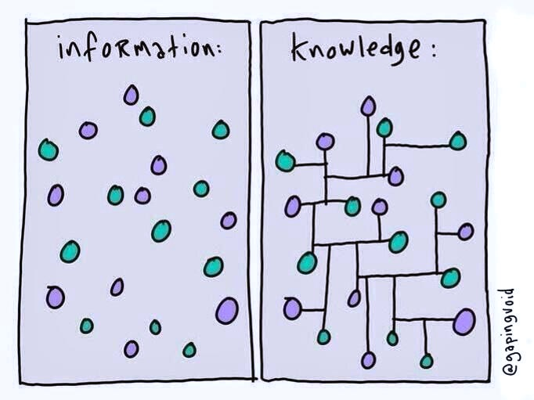
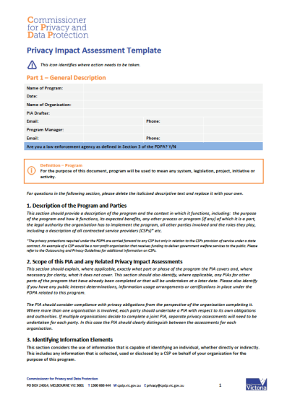
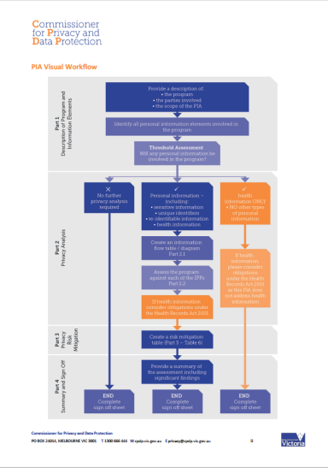
Information Privacy in Victoria
Information sharing can bring tremendous benefits

Slide 19
Information Privacy in Victoria
However, information sharing needs to be done in a privacy-sensitive way with a clear explanation of the desired benefits, otherwise government risks losing its social licence to collect and use information.
Recent developments involving data collected by Facebook and Cambridge Analytica highlight the importance of privacy.
You’d be forgiven for thinking that younger generations don’t care about privacy. You’d also be very, very wrong.
Notes:
This is where legislation such as the Privacy and Data Protection Act and the Freedom of Information Act come in.
Each provides a legal framework for the way in which:
government collects, uses, discloses and stores personal and sensitive data, and
how an individual can seek access to information held by government and ensure any personal information held about the individual is accurate.
Such ‘information rights’ are increasingly important in order that individuals can meaningfully participate in society and understand their relationship with their government.
My office recently commenced a process of strategic and operational planning for the years ahead. As part of that process, I put the following deliberately provocative question to staff: Why do we need to govern how the public sector collects, stores, uses, discloses and secures information?
One of the answers that came back was, in part, that in the information age, control over information is essential to the establishment of individual identity. We are not talking there about a proof of identity process to access a product or service. Instead, we are talking about what it means to be human in the digital age.
Upholding the privacy of an individual’s personal information is paramount for a number of important reasons:
Privacy is recognised as a human right, internationally under Article 17 of the International Covenant on Civil and Political Rights. It is also enshrined in s 13 of the Victorian Charter of Human Rights and Responsibilities.
There are significant economic and social benefits in establishing strong relationships between government and the public based on trust and transparency.
People need to feel secure in the knowledge that government is handling their information appropriately and lawfully. That confidence, in turn, builds the social licence given to government to deal with individuals’ data as the public has trust in the public sector’s stewardship of their personal information.

Slide 20
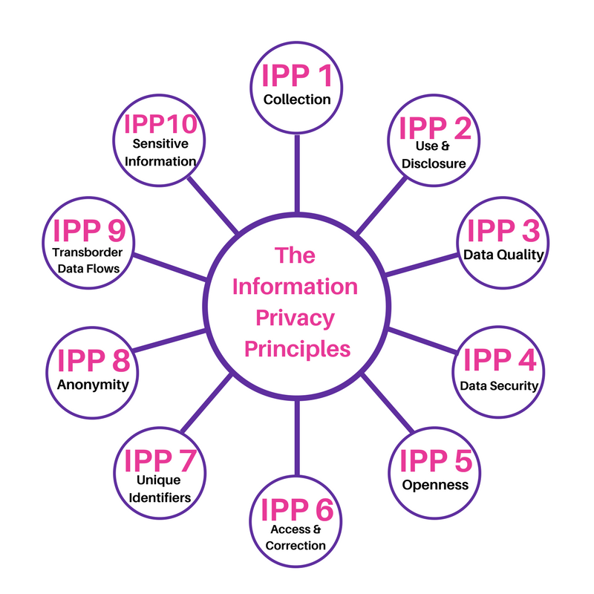
The Information Privacy Principles
P
The IPPs set the minimum standards for the collection and handling of personal information in the Victorian public sector.

Slide 21
Current challenges
Data sharing for better service delivery and the prevention of harm
Collection and use of biometrics
Can privacy ever be effectively left to the market and informed individual consent?
Notes:
This is where legislation such as the Privacy and Data Protection Act and the Freedom of Information Act come in.
Each provides a legal framework for the way in which:
government collects, uses, discloses and stores personal and sensitive data, and
how an individual can seek access to information held by government and ensure any personal information held about the individual is accurate.
Such ‘information rights’ are increasingly important in order that individuals can meaningfully participate in society and understand their relationship with their government.
My office recently commenced a process of strategic and operational planning for the years ahead. As part of that process, I put the following deliberately provocative question to staff: Why do we need to govern how the public sector collects, stores, uses, discloses and secures information?
One of the answers that came back was, in part, that in the information age, control over information is essential to the establishment of individual identity. We are not talking there about a proof of identity process to access a product or service. Instead, we are talking about what it means to be human in the digital age.
Upholding the privacy of an individual’s personal information is paramount for a number of important reasons:
Privacy is recognised as a human right, internationally under Article 17 of the International Covenant on Civil and Political Rights. It is also enshrined in s 13 of the Victorian Charter of Human Rights and Responsibilities.
There are significant economic and social benefits in establishing strong relationships between government and the public based on trust and transparency.
People need to feel secure in the knowledge that government is handling their information appropriately and lawfully. That confidence, in turn, builds the social licence given to government to deal with individuals’ data as the public has trust in the public sector’s stewardship of their personal information.

Slide 22
Protective Data Security in Victoria
Notes:
The Victorian Government has committed to effectively manage protective data security risks within the Victorian public sector.
OVIC is unique in that it is the first of its kind in Australia to integrate data security and protection. Our objective is to foster a more risk based approach to protective data security.
Framework
The Victorian Protective Data Security Framework (VPDSF) is the overall scheme for managing protective data security risks in Victoria’s public sector.
The Framework seeks to introduce cultural change so that protective data security practices are reflected in everyday business operations, and all agency personnel take a shared responsibility.
The framework consists of:
The Victorian Protective Data Security Standards (VPDSS) endorsed by the Special Minister of State
The associated Assurance Model; and
Supplementary security guides and supporting resources developed by OVIC.
The Framework has been developed to help public-sector organisations manage protective data security risks by:
Identifying information assets
Assessing the value of information
Identifying and managing protective data security risks
Applying security measures
Enhancing their protective data security capability; and
Creating a positive security culture.

Slide 23
Example incident of a breach to a utilities system in 2001
A spate of mysterious faults and communications breakdowns hitting a network of 150 computer-controlled sewage pumping stations belonging to Queensland’s Maroochy Shire Council were put down to glitches in the new system.
Pumps were not running when they should, alarms were not being triggered and reported from smaller computers running each pumping station, and communications between the computers through a two-way radio link were being lost.
Notes:
At first the attacks went unnoticed.
A spate of mysterious faults and communications breakdowns hitting a network of 150 computer-controlled sewage pumping stations belonging to Queensland’s Maroochy Shire Council were put down to glitches in the new system. Pumps were not running when they should, alarms were not being triggered and reported from smaller computers running each pumping station, and communications between the computers through a two-way radio link were being lost.
Finally, an engineer from the company that installed the system began monitoring and recording all transmitted signals and messages and concluded that someone was deliberately hacking into the control system to cause the disruptions. After three months, the culprit was arrested, but not before a million litres of raw sewage was released into local waterways and $50,000 had been spent cleaning it up.
The sewage pumping system on Queensland’s Sunshine Coast may seem an unlikely spot to highlight when mapping the rising fear of international cyber terrorism, but the case of disgruntled computer expert Vitek Boden and what a judge later said was his revenge for failing to get a job with the Maroochy council has become a landmark case.
Boden’s sustained attacks in early 2000 using a laptop computer and two-way radio were studied in detail by the US National Infrastructure Protection Centre and the case has been used at international and national security conferences as the only known example of someone successfully taking over a data-control system to attack public infrastructure

Slide 24
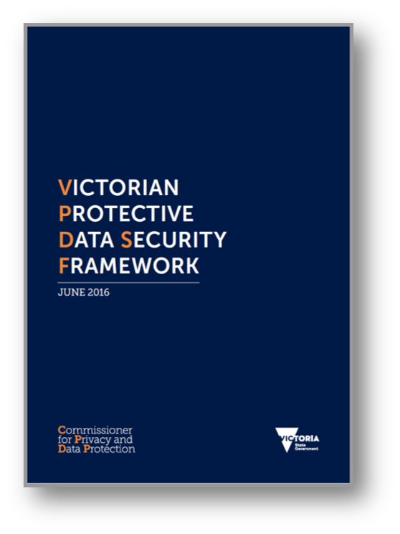
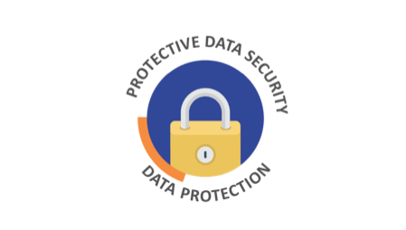
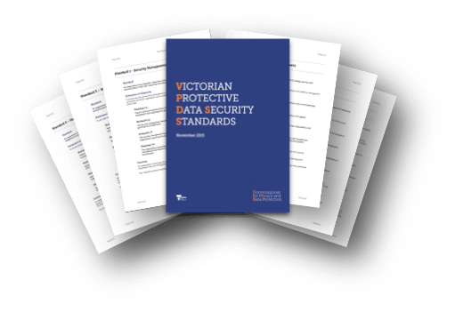
Protective Data Security
Reframing traditional thinking about security: it’s not just ICT.
Notes:
The Victoria Protective Data Security Standards: (Governance) - Purpose
The purpose of the VPDSS is to provide a set of criteria for the consistent application of risk-managed security practices across Victorian government information.
Objectives: The VPDSS is developed to help Victorian public sector organisations:
manage information throughout its lifecycle (creation to disposal)
manage information across all the security domains (information, personnel, ICT, physical)
manage security risks to information (CIA)
manage external parties with access to information
share information with other organisations with confidence
minimise security incidents.
Protective Data Security Domains - The 18 standards are presented across governance and the four security domains and feature core messages, including:
Security Governance (12 standards)
Executive sponsorship of and investment in security management, utilising a risk based approach Information Security (Three standards) Protection of information, regardless of media or format (hard and soft copy material), across the information lifecycle from when it is created to when it is disposed Personnel Security (One standard) Engagement and employment of eligible and suitable people to access information ICT Security (One standard) Secure communications and technology systems processing or storing information Physical Security (One standard) Secure physical environment (i.e. facilities, equipment and services) and the application of physical security measures to protect information.

Slide 25
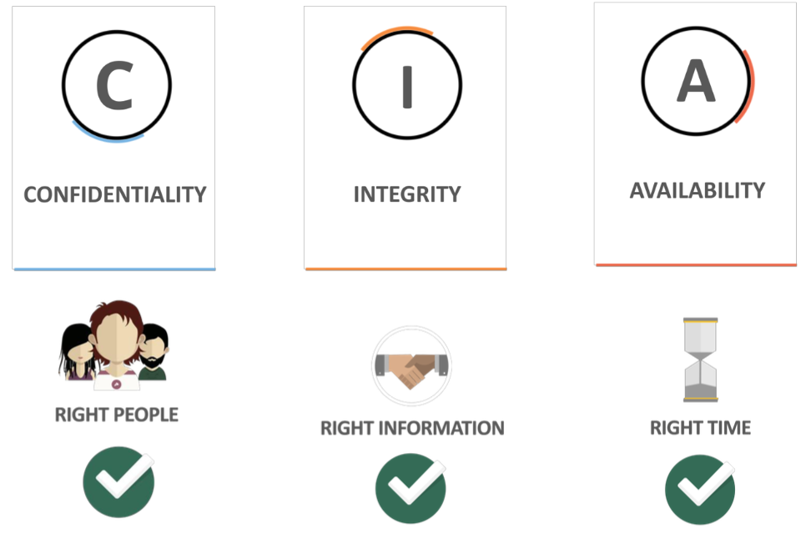
Protective Data Security
Remember: confidentiality is only one third of the picture!
Notes:
Balance may be achieved by adopting a risk based approach but this requires that the business actively manage risks to its information and assets. It isn’t a set and forget exercise
Use the ‘Defense-in-Depth’ principles by employing holistic protective security controls to offer a layered defense approach (i.e. using personnel, physical, ICT security measures, combined with Governance arrangements to mitigate risks). These can be procedural, administrative, physical or technical controls that act as a means to:
Deter
Detect
Deny
Delay
Defend
Organisations may also consider adopting a “Security by Design” approach to try to reduce the risk of being exploited. This concept is especially effective when used prior to the selection and implementation of ‘smart’ solutions, infrastructure and assets. In these instances, protective data security can be considered at design or concept stage, rather than trying to retrofit security into established solutions.
The VPDSF offers a holistic, risk-based approach to data security, focusing on organisations capability and maturity rather than compliance.
Traditional compliance-based frameworks can focus on the wrong outcome. They do have a role to play, but don’t always mean ‘effective security’. They tend to offer a checklist of sorts that organisations work through, implementing mandated controls that aren’t reflective of the value of the information or system that the organisation is working with, nor it’s risk appetite or tolerance.
Governance is key with investment in security from the top
Where are the crown jewels? – Know what and where your assets are and focus on the valuable ones. Identify and monitor the pathways to access these assets
What are the risks? Before even considering that shiny new vendor security solution, take a risk based approach – what is the risk and then what are the appropriate controls to mitigate the risk?
Consider integrity and availability when looking at security not just confidentiality
Security is not just ICT – security solutions are not just technology so consider people and process
Cover all security domains when considering security measures i.e. information security, personnel security, ICT security and physical security
Tell everyone that security is their responsibility not just the responsibility of those in the security team
Where are the vulnerabilities?
People – People are both the problem and the solution – e.g.
Problem: Malicious or negligent actions of an individual (either external persons or internal staff)
Solution: People are your first layer of defence, either by noting suspicious activity, issues or behaviours and providing important advice to their peers on how to improve security practices across the organisation

Slide 26
Information Rights in the digital age
Notes:
Access by individuals to information held by government and government’s handling and protection of personal and sensitive data about individuals are key elements of modern government and underpin the fundamental aspect of the relationship between citizens and their governments.
In carrying out their democratic and statutory functions, governments collect, handle, use and store vast quantities of personal data about their citizens. This is particularly pertinent in our increasingly digital engagement with government.
The physical service counter equipped with staff and paper is being replaced by online portals with the ability to collect, use and share personal information at the touch of a button.
There is immense value in the personal information held by government and the private sector alike. In this morning’s press, Australian Competition and Consumer Commission chairman Rod Sims said that consumers should not think of Facebook or Google as free services, because there is a cost to giving the tech giants so much personal data.
To this end, the ACCC inquiry into the impact of major digital platforms will investigate whether users are being misled about that cost. Mr Sims went on to say “there is nothing free in this world. So if someone is providing you something for free you need to think ‘how is that so?’.”
You can tell that I am not a millennial because I just referred to “reading this morning’s press” rather than getting my news on Facebook. And it is often asserted that younger generations are much less concerned about privacy, or even not significantly concerned about privacy at all. “Privacy is dead – got over it”.
But in my view, that has always been an unfair oversimplification. I believe that younger generations are very savvy about their information rights, even if that savvy manifests itself in ways that are quite different to previous generations. Recent surveys both in Australia and abroad bear this out. One of these surveys distinguished between “older Millenials” and “younger Millenials”. I did find that a little depressing.
In the public sector context, much of the most valuable data to which government has access contains personal information about individuals. Used appropriately, this information enables government agencies to make informed decisions and provide better policy and service responses to the issues of the day.
But government and personal data is not a one way street.
In order for government to legitimately collect and use the personal information of its citizens, it needs to ensure that it maintains a trusted relationship with its citizens who are assured that their personal information will not be misused or shared unlawfully. Without trust, the social compact that effectively exists between society and government is severely weakened.
It follows then that citizens have a general, if not unfettered, right to access information held by government, and should be entitled to trust that government is only collecting personal information necessary for its functions. Where it does collect such information, citizens have a right to expect that government securely stores this data and that any use of the data is lawful and in line with reasonable community expectations.
Note – you may wish to speak to “In 2013 the police chief in Reading, Pennsylvania invested in a predictive policing tool.” "If you run your city off of data, you ignore culture, you ignore politics, you ignore social conflicts, you ignore history … you miss all the messy humanness of places."

Slide 27
Questions?
OVIC: 1300 00 6842
Email: enquiries@ovic.vic.gov.au
www.ovic.vic.gov.au
Twitter @OVIC_AU

