Slide 1
Sharing personal information: The basics
Lightning talk 3 -
An introduction or refresher for VPS employees on the rules around sharing personal information.
PAW 2021

Slide 2
What we’ll cover today
PAW 2021
Brief overview of privacy law in Victoria
Information Privacy Principle (IPP) 2 and sharing personal information
ways personal information can be shared;
considerations before sharing personal information; and
the barriers and benefits to sharing personal information.
IPP 2 in practice

Slide 3
Privacy law in Victoria

Slide 4
Legislative framework
PAW 2021
Privacy and Data Protection Act 2014 (Vic) – The IPPs
VPS organisations and their contracted service providers.
Covers personal information but not health information.
Health Records Act 2001 (Vic) – The HPPs
Public and private organisations handling health information
Privacy Act 1988 (Cth) – The APPs
Federal agencies and private organisations with >$3million annual turnover
But also ‘TFN recipients’
Charter of Human Rights and Responsibilities Act 2006 (Vic)

Slide 5
The Privacy and Data Protection Act 2014 (Vic)
PAW 2021
Part 3 – Information Privacy
Provides for the responsible collection and handling of personal information in the Victorian public sector
Applies to all Victorian public sector organisations, including:
Government departments
Ministers
Local councils
Universities and TAFEs
Contracted service providers

Slide 6
The Information Privacy Principles (IPPs)

Slide 7
The Information Privacy Principles
PAW 2021
The IPPs set the minimum standards for the collection and handling of personal information in the VPS.
Collection
Use & Disclosure
Data Quality
Data Security
Openness
Access & Correction
Unique Identifiers
Anonymity
Transborder Data Flows
Sensitive Information

Slide 8
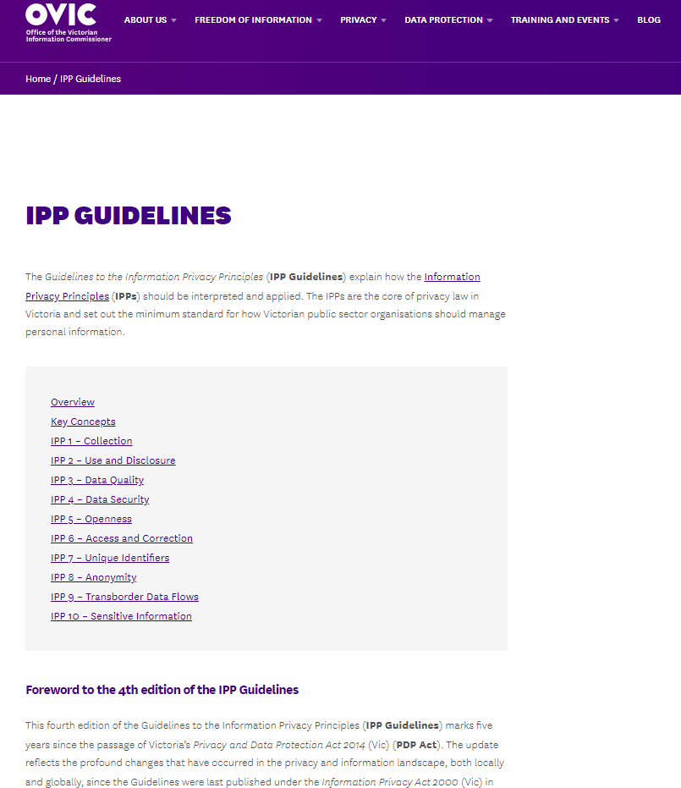
Guidelines to the Information Privacy Principles
PAW 2021
https://ovic.vic.gov.au/privacy/guidelines-to-the-information-privacy-principles/

Slide 9
What is information sharing?

Slide 10
Information sharing (inter and intra)
PAW 2021
Information sharing refers to the collection, use and disclosure of personal information either within an organisation or between organisations. Information sharing can occur in many ways including:
one organisation disclosing information (the disclosing organisation) to another (the receiving organisation);
multiple organisations combining information in a database and making it available to each other; and
the reciprocal exchange of information between organisations.

Slide 11
Use vs disclosure
PAW 2021
Where personal information is shared within the same organisation, the organisation uses the information that it holds.
Where personal information is shared with another legal entity, the organisation discloses the information it holds.
When the organisation discloses information to another organisation, the receiving organisation necessarily collects that information.

Slide 12
Ways personal information can be shared
PAW 2021
Systemic information sharing
Routine exchange of information for a specified purpose
Should be governed by a written agreement or protocol
Ad-hoc information sharing
One-off disclosure or collection of personal information
Should make a written record of the request and rationale for sharing the information
Information sharing vs information release
Information sharing = making information available under specified condition
Information release = making information openly or publicly available with few or no restrictions on use or access

Slide 13
Considerations before sharing personal information

Slide 14
Considerations before sharing personal information
PAW 2021
Type of personal information to be shared and value of the information
Purpose of sharing
Permission to share personal information
Enabling legislation
IPP 2

Slide 15
IPP 2.1 – Use and Disclosure

Slide 16
IPP 2.1 - Primary purpose
PAW 2021
Organisations may use and disclosure personal information for the primary purpose for which it was collected.
The primary purpose = the main reason the personal information was collected
The purpose for collecting the information can be inferred from the circumstances of the collection.
Linked to collection notices – organisations should have already explained the primary purpose of collection to the individual.

Slide 17
IPP 2.1(a) – Reasonably expected secondary related purpose
PAW 2021
Organisations may share personal information about an individual for a secondary purpose if:
the secondary purpose is related to the primary purpose for which the personal information was originally collected; and
the individuals would reasonably expect the organisation to use or disclose the information for the secondary purpose.

Slide 18
IPP 2.1(b) – Consent
PAW 2021
Organisations may use or disclose an individual’s personal information with their consent.
Consent is only one of the grounds for using or disclosing personal information under IPP 2.1. Personal information can be shared without an individual’s consent.
The elements for valid consent are:
Capacity
Voluntary (consider opt in or opt out models)
Informed
Specific
Current

Slide 19
IPP 2.1(e) – Investigating suspected unlawful activity
PAW 2021
Where an organisation has reason to suspect that unlawful activity has been, is being, or may be, engaged in, IPP 2.1(e) allows personal information to be used or disclosed:
as a necessary part of the organisation’s investigation of the matter; or
in reporting the organisation’s concerns to relevant persons or authorities.

Slide 20
IPP 2.1(f) - Required or authorised by law
PAW 2021
Organisations can use or disclose personal information for a purpose other than the primary purpose, if such use or disclosure is required or authorised by or under law.
‘Required by law’ = a legal obligation to use or disclose personal information in a particular way. Extends to warrants, court orders and statutory provisions.
‘Authorised by law’ = not compulsory, discretionary. Disclose only to the extent required or authorised:
check whether the authority behind the information request is conditional or limited in some way
only disclose the information required by the request.

Slide 21
IPP 2.1(g) - Reasonably necessary assistance for law enforcement and protection of public revenue
PAW 2021
Organisations can use or disclose personal information where it reasonably believes the use or disclosure is reasonably necessary for any of five specified purposes undertaken by or on behalf of a law enforcement agency.
The organisation must reasonably believe the disclosure is reasonably necessary.
IPP 2.2 – requires the organisation to make a written record of the use or disclosure.
The five specified purposes are:
the prevention, detection, investigation, prosecution or punishment of criminal offences or breaches of a law imposing a penalty or sanction;
the enforcement of laws relating to the confiscation of the proceeds of crime;
the protection of the public revenue;
the prevention, detection, investigation or remedying of seriously improper conduct; or
the preparation for, or conduct of, proceedings before any court or tribunal, or implementation of the orders of a court or tribunal.

Slide 22
Barriers to sharing personal information

Slide 23
Barriers to sharing personal information
PAW 2021

Slide 24
Benefits of sharing personal information

Slide 25
Benefits of sharing personal information
PAW 2021

Slide 26
IPP 2 in practice

Slide 27
Example One
PAW 2021
A representative from a law enforcement agency (LEA) calls your organisation and requests information about an individual who has been receiving services provided by your organisation.
The LEA says it needs the information for an investigation.
Does your organisation have to provide the information to the LEA?
What are some steps your organisation should take when considering whether to share this information?

Slide 28
Example Two
PAW 2021
A government department writes to your CEO and requests information about ratepayers whose payments are long overdue.
The department is proposing to subsidise rates for certain groups likely to experience financial hardship. They need data to target this assistance. Your CEO is excited about the program and wants to help.
You call the department and ask how your authority can make the disclosure under the PDP Act. They say: ‘Don’t be difficult. Everything is okay, there are no privacy issues. We’ve had legal advice.’
What should you do?

Slide 29
Questions?

Slide 30
IPP 2 – Pocket Guide

Slide 31
Want to Learn More?
GENERAL
enquiries@ovic.vic.gov.au
1300 006 842
PRIVACY
privacy@ovic.vic.gov.au
DATA PROTECTION
security@ovic.vic.gov.au
FREEDOM OF INFORMATION
foi@ovic.vic.gov.au
ONLINE
www.ovic.vic.gov.au
Monthly Newsletter
Our Blog
Free Online Learning
Guidance on the IPPs
TWITTER
@OVIC_AU

