Slide 1
Blueprint & tools for making privacy a priority
Privacy Awareness Week 3 May 2021

Slide 2
What we’ll cover
WHY make privacy a priority?
HOW to make privacy a priority?
The Blueprint – organisational planning for good privacy protection.
The Tools – putting the plan into practice.

Slide 3
Why make privacy a priority?
Information privacy crucial to broader human right to privacy. Relates to an individual's ability to determine for themselves when, how, and for what purpose their personal information is handled by others.
Ensures human dignity and self-determination. Ability to freely develop personality.
Impacts of interferences with privacy for individuals – e.g. physical, emotional, reputational harm
Impacts of interferences with privacy for society e.g. lack of public trust in government
Benefits for your organisation – reputation and public trust.

Slide 4
‘The right to privacy is central to the enjoyment and exercise of human rights online and offline. It serves as one of the foundations of a democratic society and plays a key role for the realization of a broad spectrum of human rights, ranging from freedom of expression and freedom of association and to the prohibition of discrimination and more’.
- The right to privacy in the digital age: Report of the United Nations High Commissioner for Human Rights

Slide 5
How to make privacy a priority 1 – the Blueprint
Privacy Management Framework
https://ovic.vic.gov.au/privacy/privacy-management-framework/

Slide 6
Privacy Management Framework

Slide 7
Privacy Management Framework
PART 1 – ORGANISATIONAL COMMITMENT
Building a culture of respect for privacy.
Executive and senior leadership promote good privacy practices and demonstrate good privacy values.
Using existing governance arrangements to raise privacy issues.
Appointing key roles and responsibilities for privacy management.
Senior staff with accountability and clear reporting.
Day to day privacy – Privacy officer or team
Privacy by Design approach to projects and initiatives involving PI.

Slide 8
Privacy Management Framework
PART 2 – PRIVACY PRACTICES and processes
Robust and effective practices and processes around handling personal information.
Tailored to individual functions and activities an organisation undertakes.
Apply across full ‘information lifecycle’.
Joint statement from Privacy Authorities Australia around making privacy a priority:
Organisations and agencies entrusted with personal information need to build in privacy protections to their systems and services from the ground up. A privacy-by-design approach means assessing privacy issues early and minimising risks from the outset.

Slide 9
Examples:
Induction and training
Outlining to staff how to handle PI in everyday duties
Managing assets and risk
Privacy Impact Assessments
Information sharing
Data breaches
Contracted service providers
Privacy policy
Collection notices

Slide 10
Privacy Management Framework
PART 3 – MONITOR, REVIEW, AND IMPROVE
Monitor and review policies and processes regularly to ensure they are up to date and fit for purpose.
Establish a process to measure or evaluate the effectiveness of the privacy practices, processes, and resources.

Slide 11
How to make privacy a priority 2 – the Tools
Privacy Officer Toolkit

Slide 12
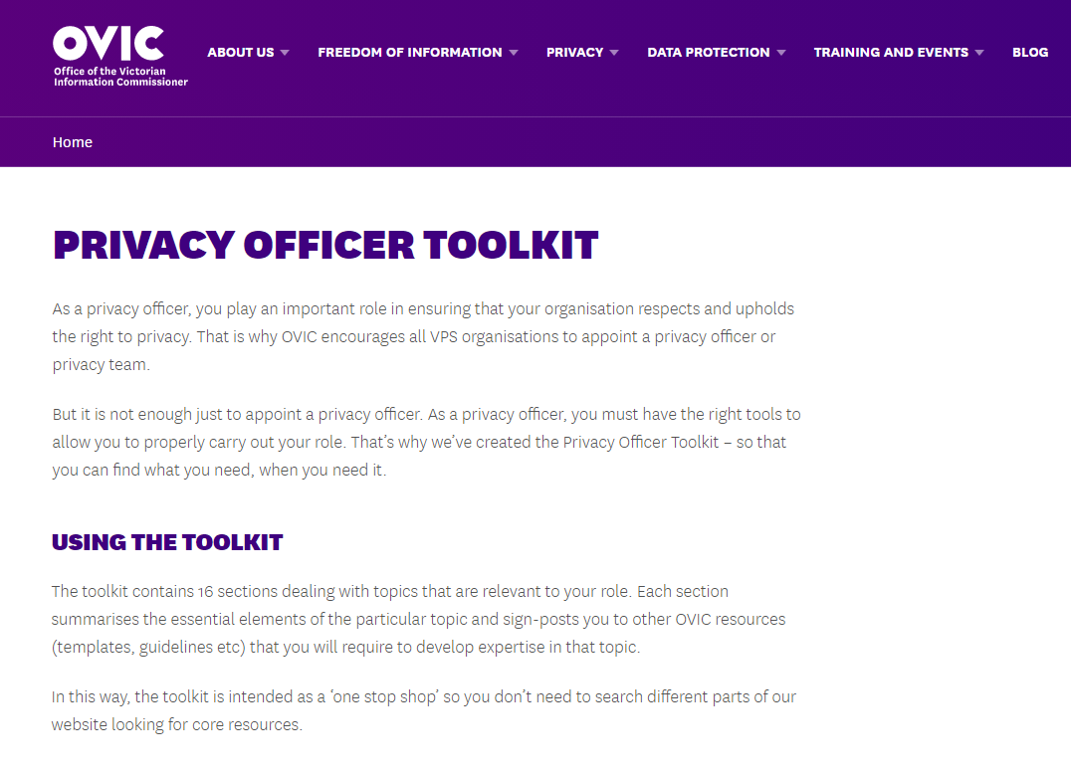
Privacy Officer Toolkit

Slide 13
Privacy Officer Toolkit
Importance of privacy
Role of Privacy Officer
Privacy Law
PDP Act
Planning
Internal enquiries
Raising awareness
Privacy Policies
Collection notices
PIAs
Privacy complaints
Data breaches
Working with OVIC
Staying up to date
Common topics
Useful resources
Each Section:
Explains topic
Relevance to role
Sign-posts to other resources required to develop expertise in that topic.

Slide 14
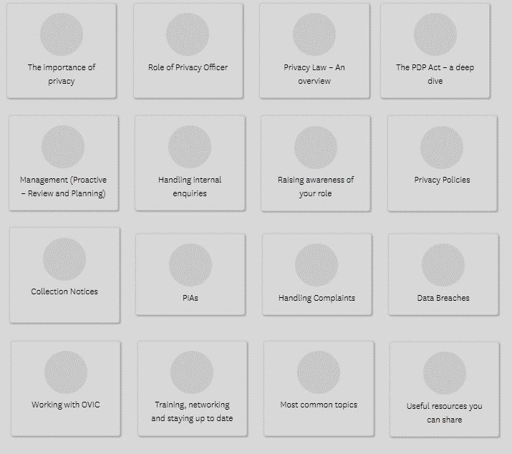
The Toolkit

Slide 15
Questions?

