Slide 1
Western Regional FOI Roadshow 17 November 2020
Western region - Ballarat, Ararat, Hepburn, Pyrenees, Golden Plains, Moorabool, Geelong, Surf Coast, Colac Otway, Moyne, Warrnambool, Glenelg, Corangamite, Southern Grampians and West Wimmera.

Slide 2
EVENT PROGRAM
12:05pm – 12:20pm Open and welcome, Keynote address
Sven Bluemmel, Information Commissioner
12:20pm – 12:30pm
OVIC update
Shantelle Ryan, Assistant Commissioner- Public Access Operations and Compliance
12:30pm – 12.45pm
Barwon Health
Presentation – Regional reflections on FOI
Bernadine McNamara,
General Counsel
Melisa Robinson,
Health Information Services Operations Manager
12:45pm – 12.55pm
Transport Accident Commission
Panel discussion
Louise Barclay, Senior Manager
Client Voice, Scheme Performance
Felicity Wright, Information & Privacy Manager
Client Voice, Scheme Performance
12:55pm – 1:05pm - break
1:05pm – 1.15pm
OVIC Presentation- Tyrrell Davidson, Principal Case Manager
1:15pm – 1:25pm
OVIC Presentation - Paul Pittorino, Manager, Complaints and Professional Standards
1:25pm -1:40pm – Q & A
1:40pm – 1:45pm – Joanne Kummrow, Public Access Deputy Commissioner – closing remarks

Slide 3
Shantelle Ryan, Assistant Commissioner Public Access, Operations and Compliance OVIC

Slide 4
Proactive and Informal Release
In a democratic society, the right to access information held by Government is essential for a transparent and accountable government.
Release of information promotes and facilitates greater public participation and scrutiny, it supports better decision-making and can enhance the public’s trust in government.
For the 2019-2020 financial year, there were 40,951 FOI requests made to Victorian Government agencies. That is a record high and an increase of 5.34% from the previous year.
As the number of FOI requests increases each year, there are real benefits for agencies to proactively release information (that is, without a request having been made) or informally release information outside the FOI Act (in response to a request for information).
We know that processing FOI requests can be time consuming process for both agencies and applicants. There is also an administrative burden on agencies to process more requests with limited FOI resources and within statutory timeframes.
Proactive and informal release complements and is consistent with an agency’s obligations under the Act, which is to make the maximum amount of information available, quickly and at the lowest cost.

Slide 5
Proactive and Informal Release Strategies
Four strategies that agencies have implemented to support release outside the Act:
A clearly communicated position for business areas outside the FOI unit, so those other areas are empowered to release information without a request from the FOI unit.
A written policy on Proactive and Informal Release to help educate wider business areas regarding the type of documents that can be released and encourage those areas to release the information without approval from FOI unit.
A published disclosure log (that is, a record of the type of documents that have been previously released) to promote informal release and increase awareness across the agency; and
Publish comprehensive information in places that are easily, and frequently accessed by the public or others likely to request those types of documents (such as the media).

Slide 6
Key messages
COVID-19
FAQs for agencies and the public available on OVIC’s website;
Please contact OVIC if your agency is impacted by COVID-19 and you require further information or assistance in meeting your obligations under the FOI Act.
BENEFITS OF PROACTIVE & INFORMAL RELEASE
Consistent with an agency’s obligations under the FOI Act;
Promotes transparency and accountability by increasing the public’s access to government information;
Reduces the need for FOI requests; and
Enhances public trust in government.
RESCOURCES
OVIC’s Agency Information Service – to be launched
Check out OVIC’s website for de-identified decisions and practice notes; and
OVIC’s training, education and online resources

Slide 7
Tyrrell Davidson, Principal Case Manager
OVIC

Slide 8
Administering the FOI Act
Formal reviews process
Consultation and notification
Published decisions

Slide 9
Formal Public Access Reviews process
Further enquires
Document assessment
Recommendation and
Decision
Formal decision by Decision Maker
Case Manager contact with Applicant and Agency
Request for further information or written submissions
In-depth assessment of all documents
Enquiries to the agency and or the applicant
Preliminary view

Slide 10
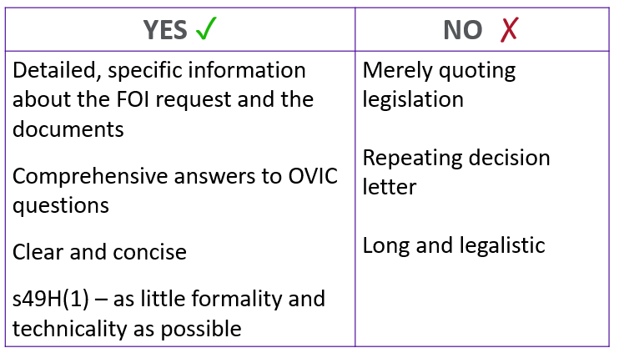
Reviews – how to assist OVIC
Document transfer forms / marked up documents
Written submissions

Slide 11
Consultation and notification
Why consult?
Required by law except where exceptions apply.
Provides valuable information to make your decision.
Involves third parties in the decision at the beginning of the process.
It demonstrates good decision making, as you evaluate information from different perspectives.
You can feel more confident in your decision making.
When to consult?
Sections 29, 29A, 31, 31A, 33, 34, 35, where practicable.

Slide 12
Consultation and notification
When is consultation practicable?
Professional Standard 7, Practicability of consulting third parties.
The likelihood a third party will not consent to disclosure of information or a document.
The age of the information or a document
The number of third parties to be notified
Whether the agency has, or is reasonably able to ascertain, current contact details for a third party

Slide 13
Consultation and notification
How to consult?
Consultation may occur in any manner or form. This might include by telephone, email, post, or a meeting.
Disclosing the applicant’s identity.
Copy of requested documents, with irrelevant or otherwise exempt information deleted.
If the third party objects, ask why.
Advise that their views are not determinative.
Notification after making a decision
Following consultation in accordance with sections 33, 34 or 35, any third party that objected to the release must be notified of their right to seek a review by VCAT of the agency’s decision.

Slide 14
Record keeping
Professional Standard 7.1, Practicability of consulting third parties
If an agency determines it is not practicable to notify and seek the views of a third party, it must keep a record of why it is not practicable.
Where an agency notifies and seeks the views of a third party, it must ensure it keeps a record of:
(a) who was notified;
(b) whether the third party did or did not respond to the notification;
(c) if the third party responded, whether they consented or objected to disclosure of the information or document; and
(d) where provided, the third party’s reasons for objecting.
Note: an agency should ensure a third party is aware of the applicable exemption and what must be established for the exemption to apply to the information or document.

Slide 15
FOI review published decisions
Published to OVIC website and Austlii

Slide 16
Paul Pittorino, Manager Complaints and Professional Standards OVIC

Slide 17
Overview
Professional Standards
Standards & Themes
Associated Project
FOI Complaints
Trends
Complaint handling at OVIC

Slide 18
The Standards
Commenced December 2019
33 standards, based on 10 themes
Professional Standards matters = “Engagements”
Identified in multiple ways

Slide 19
Themes

Slide 20
Time – Standard 2
Concerns receiving a request
An agency has a duty to assist an applicant to make a request in a manner that complies with section 17 of the Act – section 17(3) of the Act. An agency is also required to provide an applicant with a reasonable opportunity to consult where the request does not provide sufficient information, as is reasonably necessary, to enable the agency to identify the requested document – section 17(4) of the Act.

Slide 21
Time – Standard 2.4
Prescribes an agency that receives a request that is not valid must take reasonable steps to notify an applicant within 21 days of receiving the request:
Why the request is not valid
Provide reasonable assistance
Advise the request may be refused

Slide 22
Time – Standard 5
Concerns substantial and unreasonable diversion of resources
An agency cannot rely on section 25A(1) of the Act unless it has provided an applicant with a reasonable opportunity to consult with the agency, and as far as reasonably practicable, provided any information that would assist the applicant to make a request in a form that removes the ground for refusal – section 25A(6) of the Act.

Slide 23
Time – Standard 5.1
An agency must take reasonable steps to notify an applicant under section 25A(6) of the Act of its intention to refuse a request under section 25A(1) within 21 days of receiving a valid request
5.2 (b) provide a minimum of 21 days from the date of the agency’s notice, for the applicant to respond.
5.2 (a) explanation as to why request would substantially and unreasonably divert the resources of the agency

Slide 24
Other common engagements
Standard 8, Decisions and Reasons for Decision
8.2 quality of decision letter, reasons for exemption or exception
Standard 10, working with the Information Commissioner
10.3 provision of documents to OVIC within a timeframe
10.4 provision of documents to OVIC, quality of markings

Slide 25
Communication plans and FOI
Often used to manage challenging behaviours
Cannot impact FOI rights
No jurisdiction to deal with complaints about plans or service restrictions
2.1 – email as an option
2.3 – cannot refuse if a certain form is not used

Slide 26
Self assessment tool
Currently in development
Designed to promote compliance with the standards
Allows for evaluation of practices
Aiming to launch on 2 December 2020

Slide 27
Complaints
Small piece of a much larger issue
Importance of boundary setting
Perceived advocacy vs independent and impartial regulator
3.16% increase in complaints during 2019/20
Finalised complaints are the largest in the past 5 years
Common types include delay, search, decision that documents do not exist.
COVID-19 as a factor

Slide 28
Complaint Handling
Natural Justice and Procedural Fairness considerations
Collection of new and relevant information prior to determination
Resolution can come as a result of 1 point, or multiple
The value of information learnt during a complaint
Communicating in a tailored manner, plain English

Slide 29
Complaint submissions
Can address a specific action or the entire history
Can be simple (delay) or complex (search)
No set template, avoid re-stating decision
Added value when shared with applicants
Use of section 61F – dealt with in private
Better quality decision letter = less information required

Slide 30
Complaints – final reminders
OVIC’s focus on informal resolution
1-2 submissions required to resolve most complaints
Contacting OVIC by telephone prior to written submission (where required)
Quality of decision letters
Content of submissions, varied in content
Availability of OVIC staff to discuss matters

Slide 31
Contact us
OVIC contact details
T: 1300 00 6842
E: enquiries@ovic.vic.gov.au
www.ovic.vic.gov.au

